Slide 1
Object Oriented Programming
Inheritance
Lecture 12

Slide 2
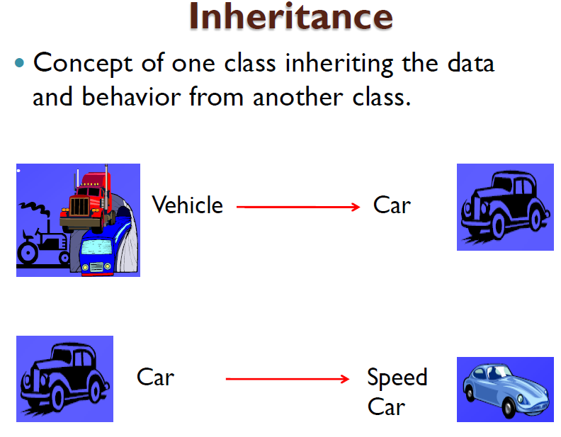

Slide 3
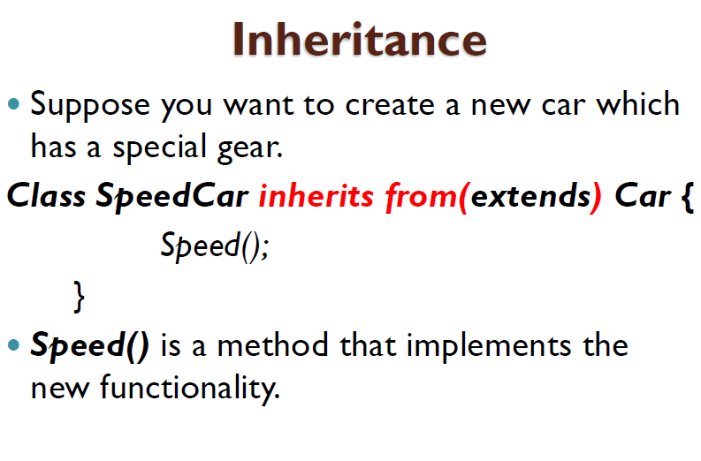

Slide 4
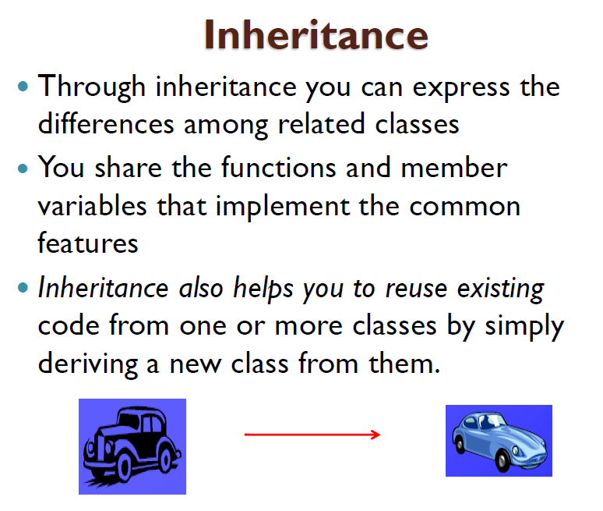

Slide 5
